Slide 1
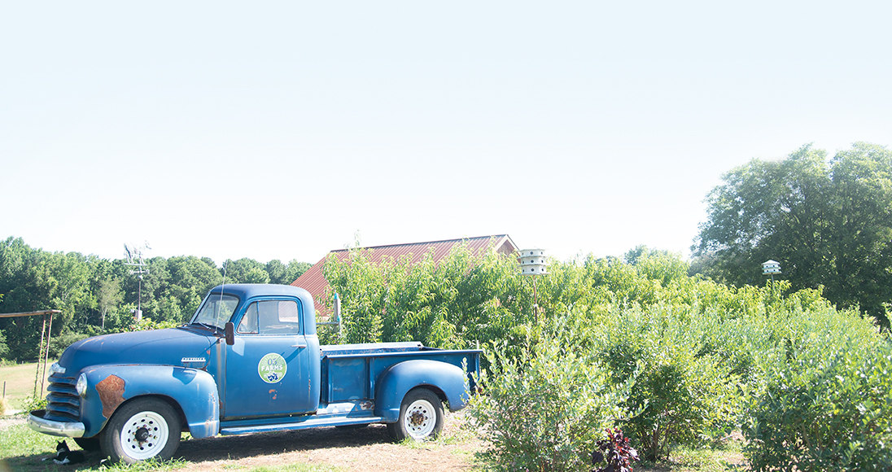
Georgia Farm Bureau
Your Name, Georgia Farm Bureau

Slide 2
About Georgia Agriculture
According to the 2022 Georgia Farm Gate Value Report, agriculture contributes approximately $18.3 billion to Georgia’s economy.
In 2022, food and fiber production and related industries contributed $83.6 billion in output to Georgia’s $1.4 trillion economy and more than 323,300 jobs in the economy.

Slide 3
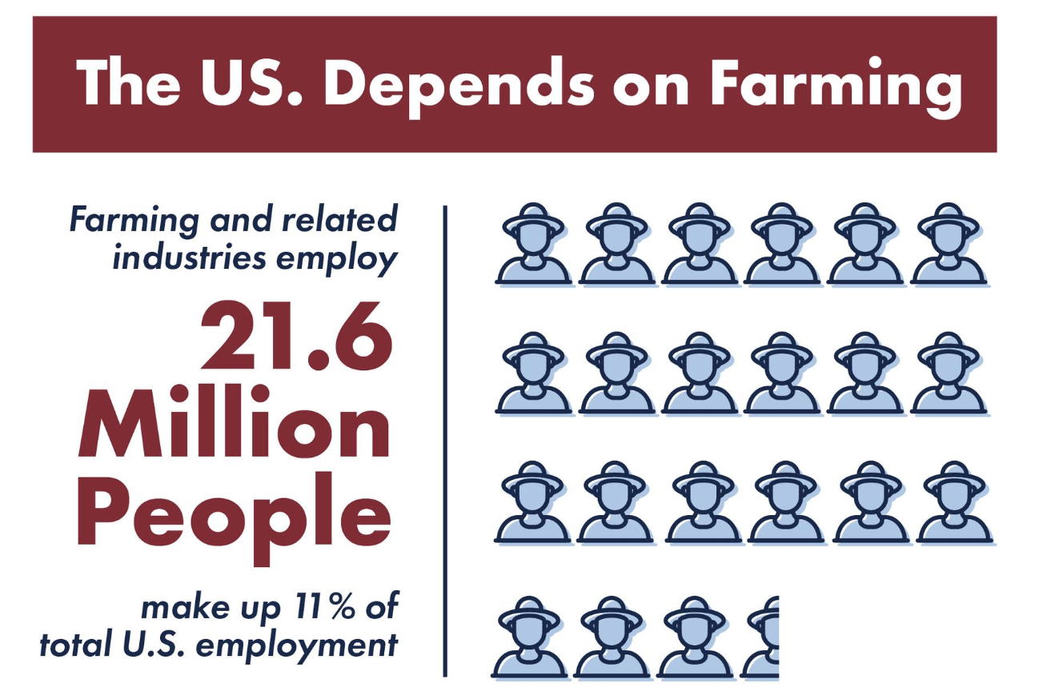

Slide 4
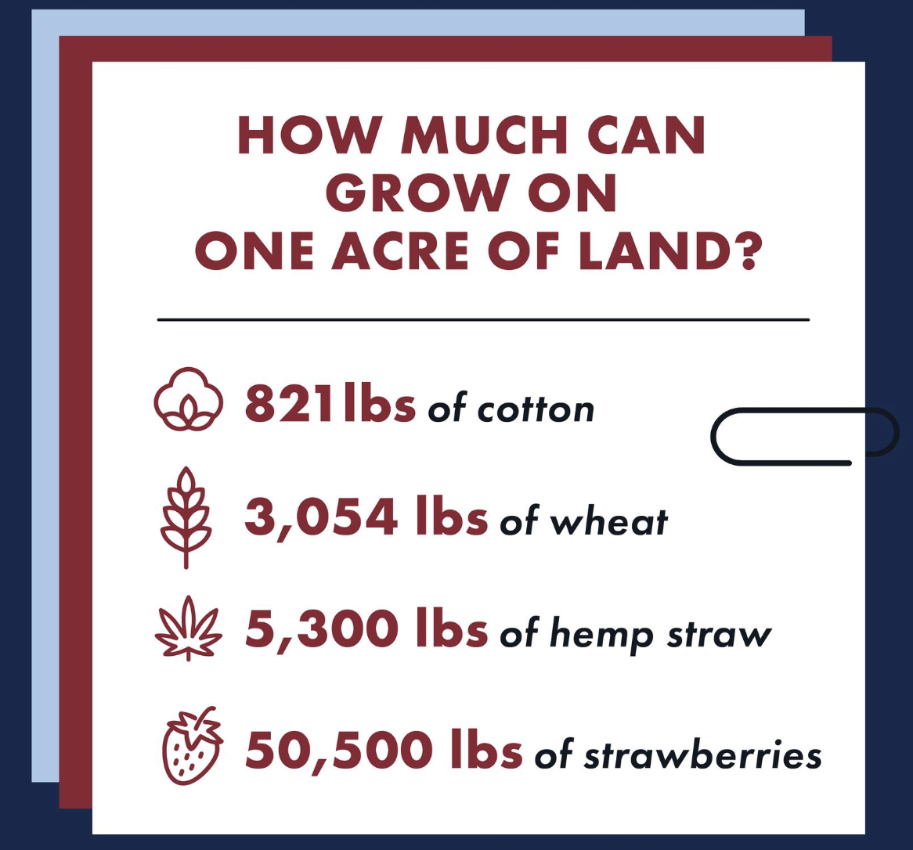
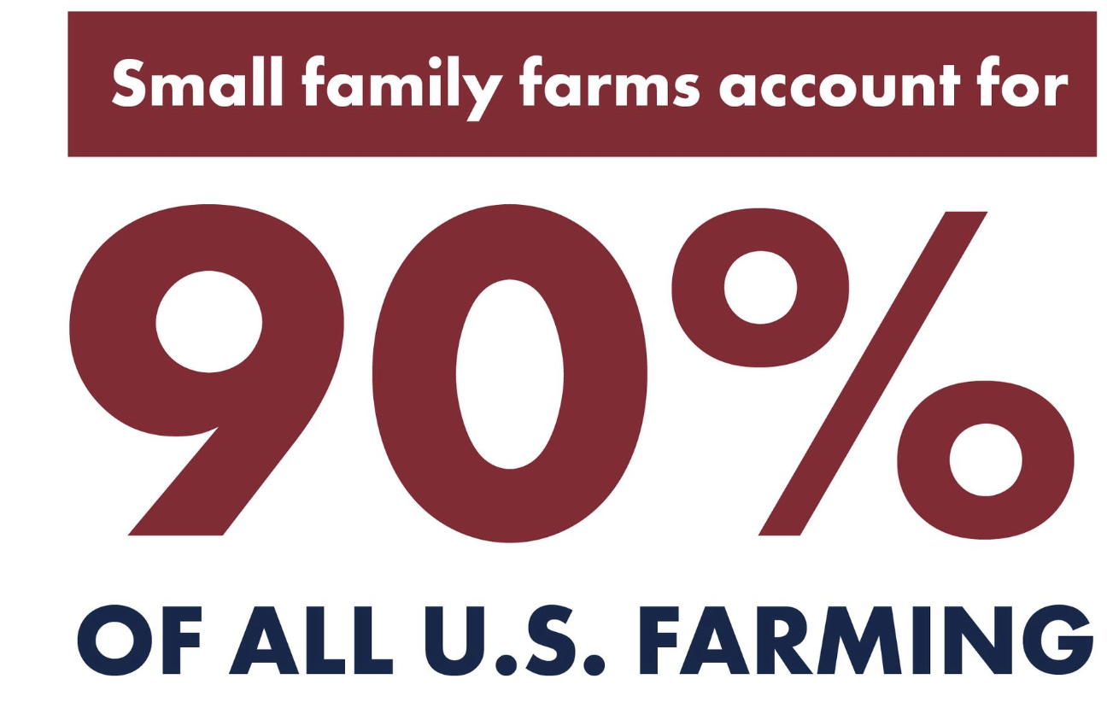

Slide 5
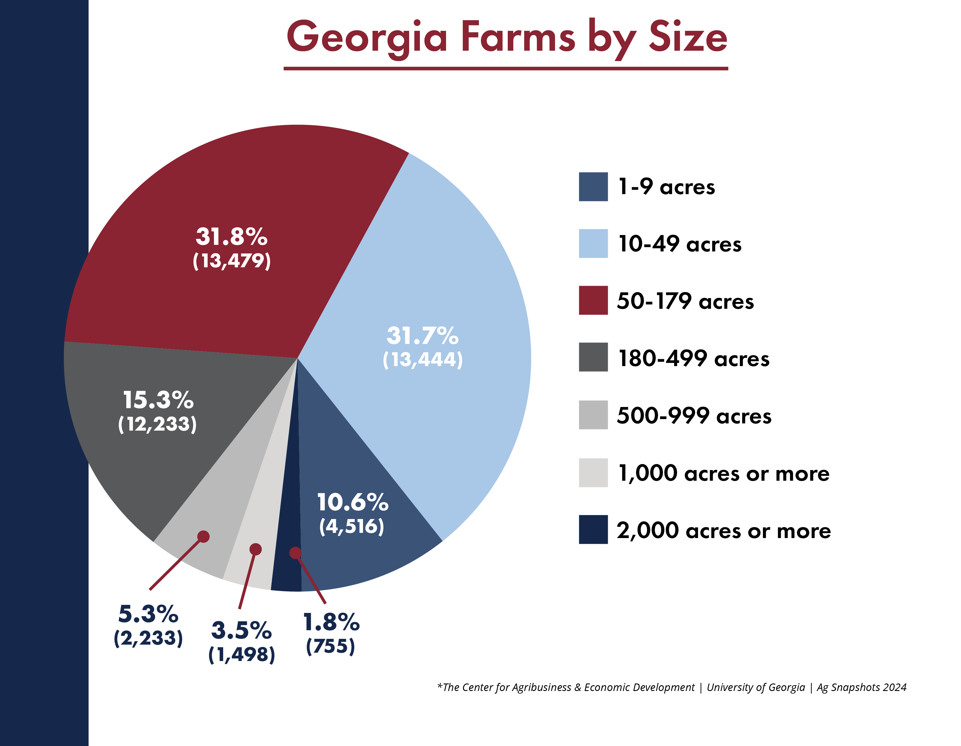
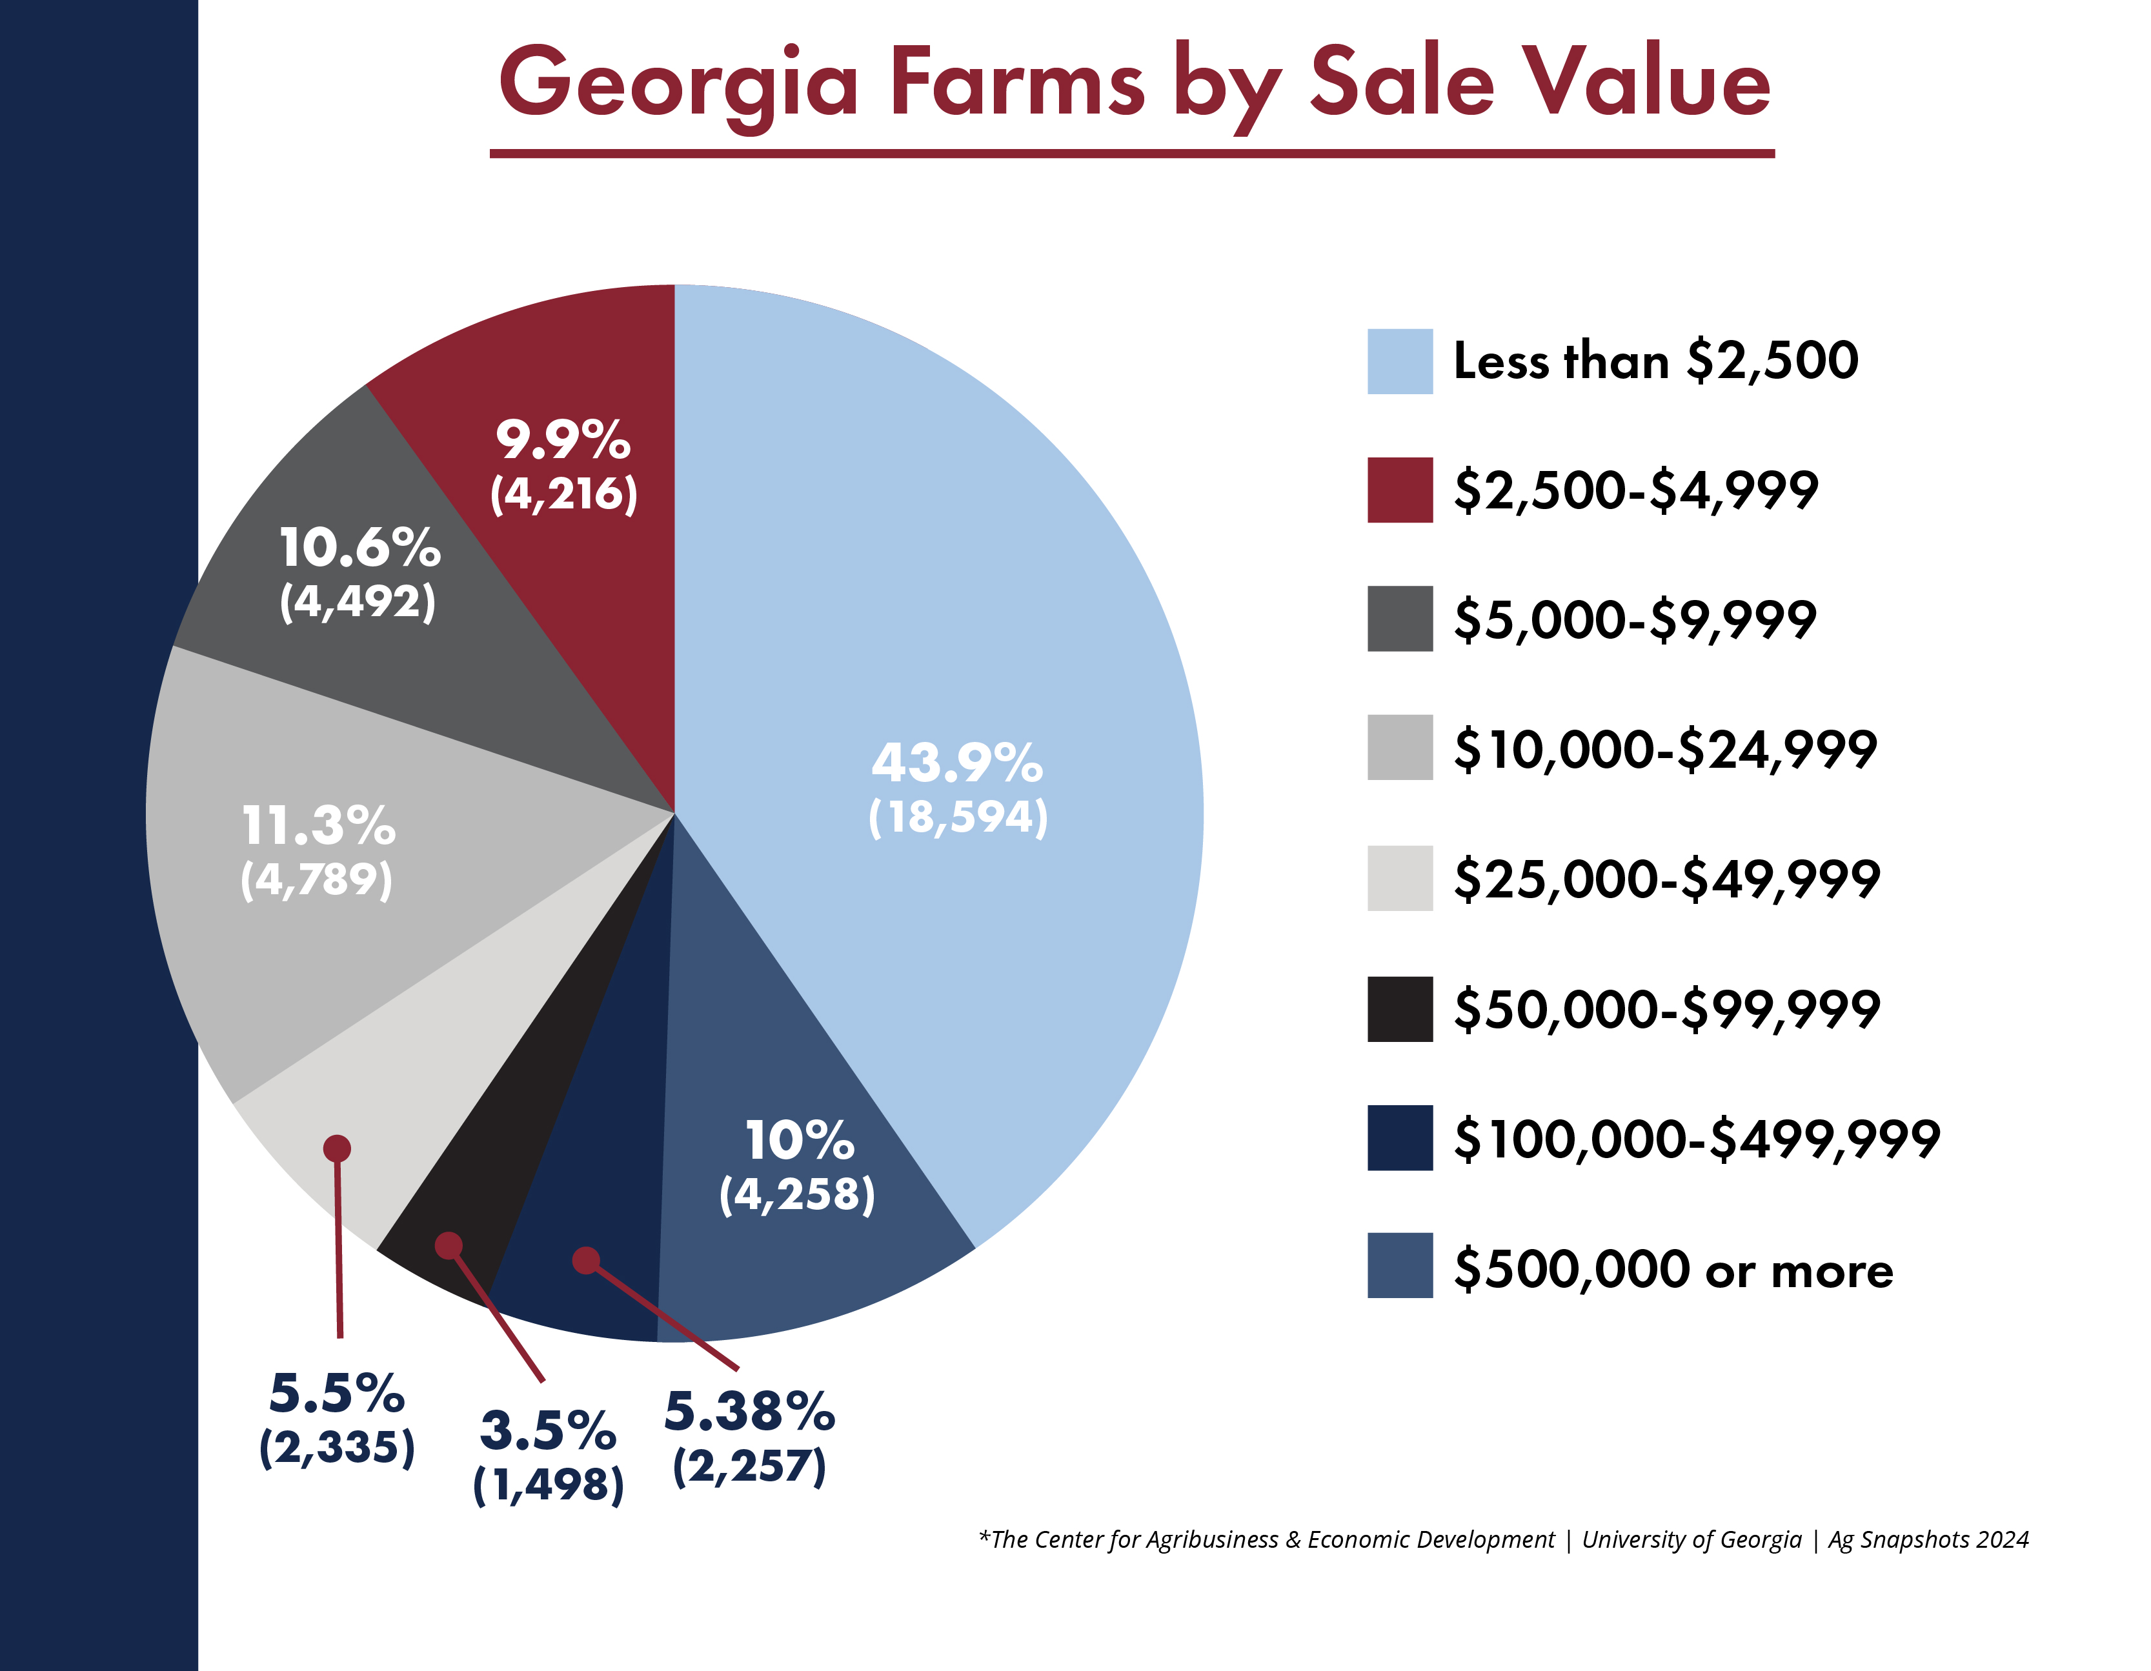

Slide 6
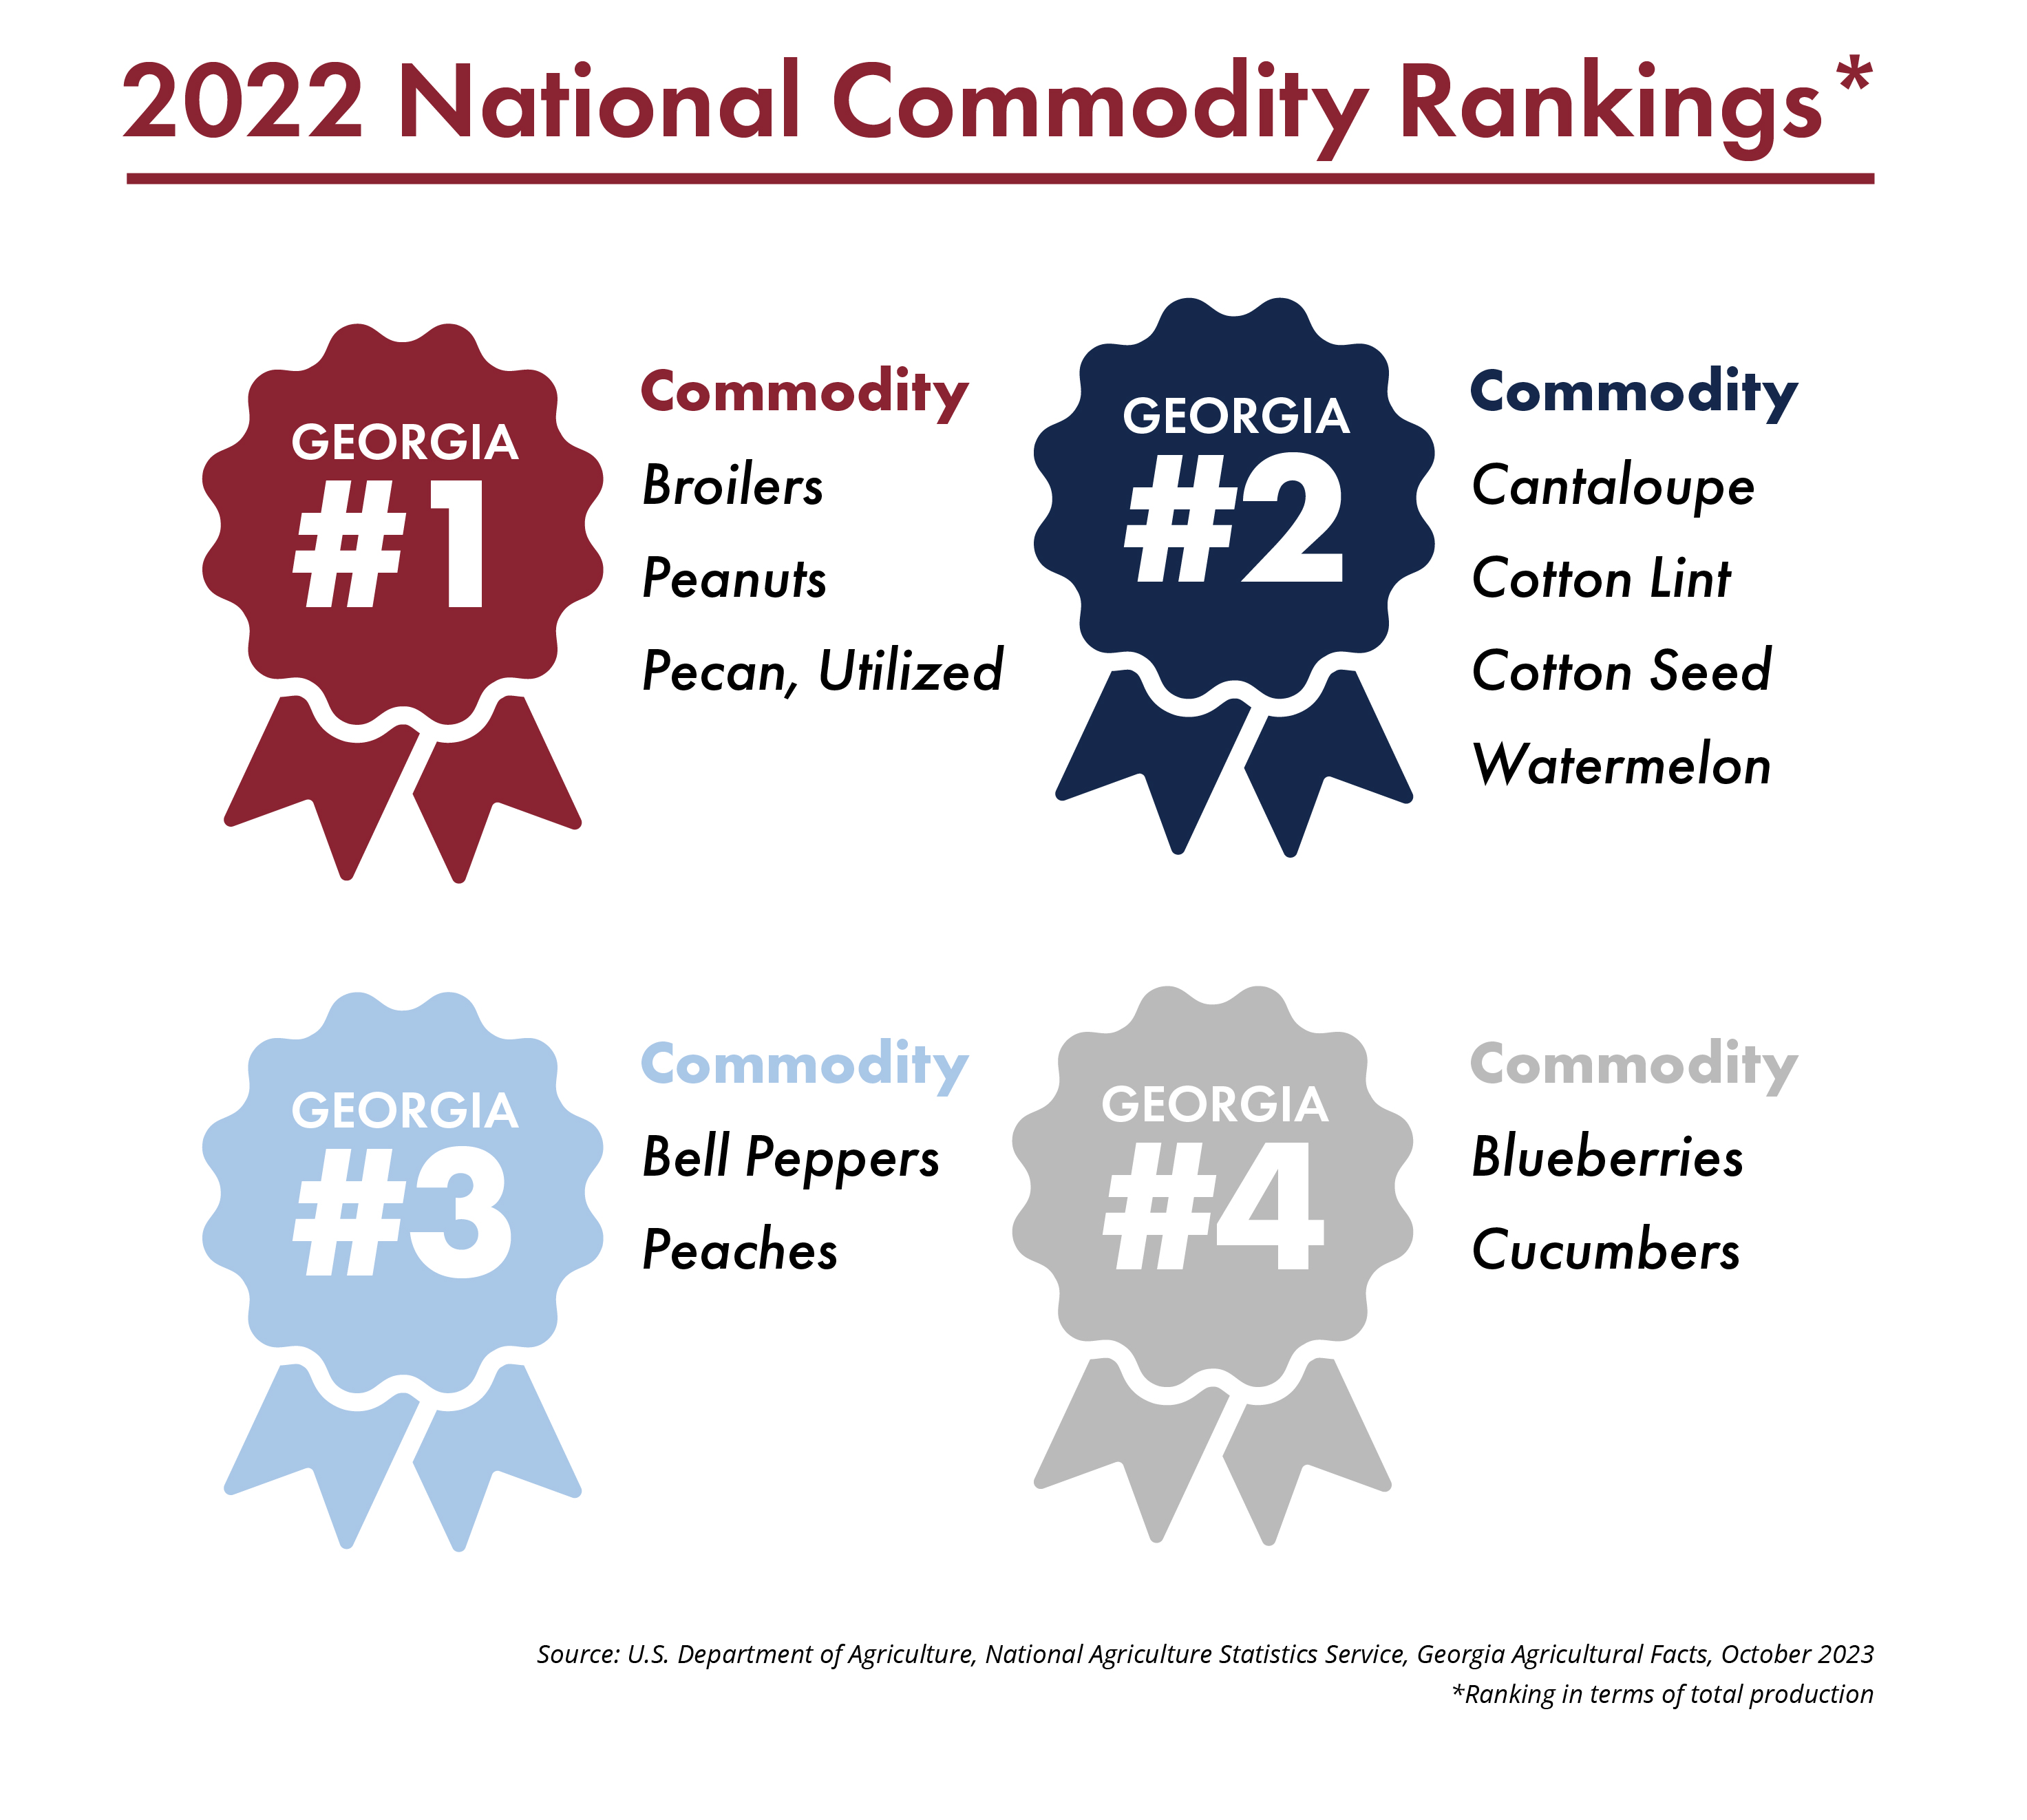

Slide 7
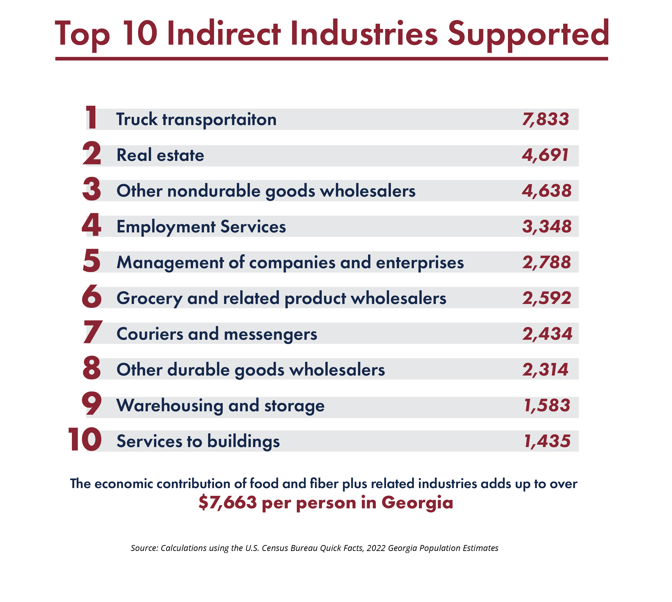

Slide 8
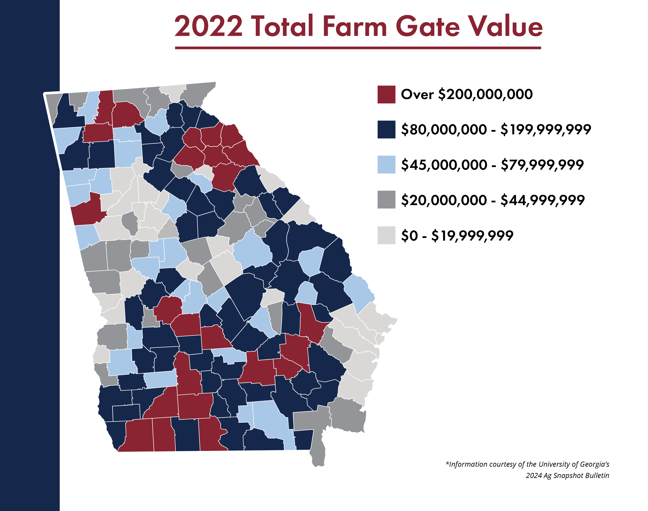

Slide 9
About Georgia Farm Bureau
Georgia Farm Bureau is a non-profit, membership-based organization whose purpose is to support family farms and promote a safe and abundant supply of Georgia-grown products.
Formed in 1937 by 50 farmers, Georgia Farm Bureau continues to have a strong grassroots network with 158 county Farm Bureau organizations.
Farm Bureau is local, state, national and international in scope and influence.

Slide 10
About Georgia Farm Bureau
Since its inception, the primary, ongoing goal of Farm Bureau is:
to be a united voice in the legislative arena
to promote farm markets
to provide leadership to Georgia's agricultural community

Slide 11
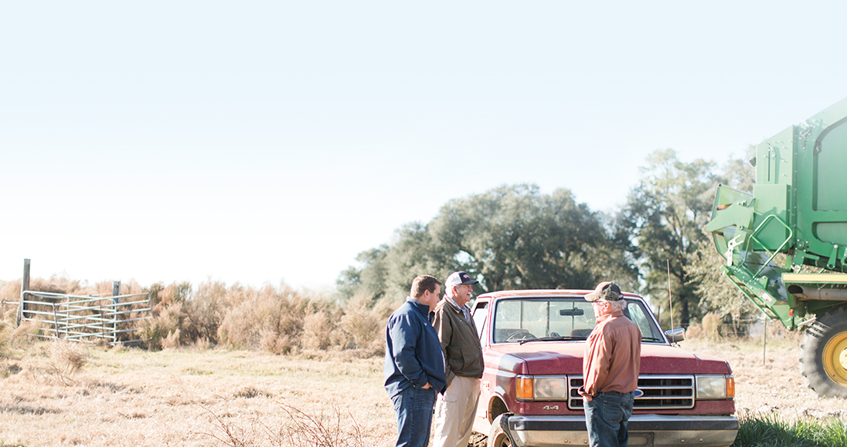
Public Policy and Advocacy

Slide 12
Public Policy
Georgia Farm Bureau's Public Policy Department is charged with pursuing one of the original purposes of Georgia Farm Bureau: to represent farmers and agriculture in the legislative arena. The department facilitates the grassroots development of Georgia Farm Bureau policy and then implements that policy through a number of legislative activities.
The Public Policy Department also serves Georgia Farm Bureau's Commodity Advisory Committees, represent GFB on the state's Agricultural Commodity Commissions, and maintain relationships with other commodity organizations and stakeholders.

Slide 13
Public Policy – Grassroots Development
The development of Georgia Farm Bureau policy is truly a grass-roots effort. This process, which began over 65 years ago, is the backbone to our organization. Policy development allows members to decide the positions we take in Washington and Atlanta. Farm Bureau is one of the few organizations that uses a true democratic process for representing members' views.

Slide 14
Public Policy – Local, State and National Focus
The other side of the Public Policy Department coin works with Farm Bureau leadership to promote the organization’s objectives at all levels of government. We assist county Farm Bureaus on local issues, work to implement state and federal policy, and inform our membership of the outcomes. Our goal is to act as an intermediate between the farmers and their elected officials. We maintain a daily presence at the State Capitol working to deliver the farmers' message and implement Farm Bureau policy.

Slide 15
GFB Programs

Slide 16
Ag in the Classroom
Agriculture is Georgia’s largest industry. It is an important component of the state’s economy and provides one in seven jobs in agriculturally related fields.
However, less than 2% of the population actually lives on the farm and few people have any knowledge of how the food and fiber system works to provide us with food, clothing and shelter.

Slide 17
Ag in the Classroom
The purpose of the Georgia Agriculture in the Classroom program is to increase agricultural literacy among children and the general public. It provides tools for more effective teaching about agriculture and its role in an interdependent society, and to assist Georgia ’s educators in implementing the instruction of agriculture-related concepts in the classroom.
This mission is achieved through the activities of county Farm Bureau volunteers in their local communities and through teacher training courses held throughout the state.

Slide 18
Free Educational Resources
Georgia Farm Bureau's Ag in the Classroom program partners with teachers and other organizations to provide free educational resources for agriculture teachers and parents. Visit GFB.org for more.

Slide 19
Farm Passport
The Farm Passport is your guide to discover Georgia, support local farms and experience fresh food. Grab your passport and let it guide you across the state to see the diversity of agriculture Georgia offers.
The Farm Passport features over 90 farms included in Georgia Farm Bureau’s Certified Farm Markets program, which was created to help people discover where their food comes from, meet the farm families who grew the food, and create lasting memories with loved ones as they travel the state.
Farm Passports can be picked up at any of the participating farms or local Farm Bureau offices. You can also download the Passport here and print at home.

Slide 20
Young Farmers & Ranchers Program
Georgia Farm Bureau regularly invests in leadership programs designed to promote agriculture. The Young Farmers & Ranchers Program is designed to:
Support farmers and make an impact for agriculture through advocacy, education, and service
Grow and develop leadership through participation in state-sponsored conferences and events
Opportunity to travel to state and national events to meet new people and build a network of like-minded individuals passionate about agriculture
Learn more about current agricultural issues and how to engage with lawmakers and representatives to advocate for agriculture

Slide 21
Women’s Leadership Committee
The purpose of the Georgia Farm Bureau Women's Leadership Committee is to promote agriculture through education and to expand participation in all phases of agriculture in order to build leadership and achieve a more effective organization.

Slide 22
Ag Information & News

Slide 23
Farm Monitor
The Farm Monitor is where you can turn each week to learn about the food you eat and the farmers who grow it. It’s the only news and information television program dedicated to Georgia’s #1 industry — agriculture

Slide 24
Agriculture News
Georgia Farm Bureau employs a team of journalists to bring you vetted, trustworthy information on Georgia agriculture.
Our journalists provide in-depth feature stories, timely updates and well-researched articles on the issues faced by Georgia and how that can affect consumers.
News is provided in a variety of formats, including:
GFB News Magazine
”Growing On” Podcast

Slide 25
Georgia Neighbors
The Farm Monitor is where you can turn each week to learn about the food you eat and the farmers who grow it. It’s the only news and information television program dedicated to Georgia’s #1 industry — agriculture

Slide 26
Member Benefits

Slide 27
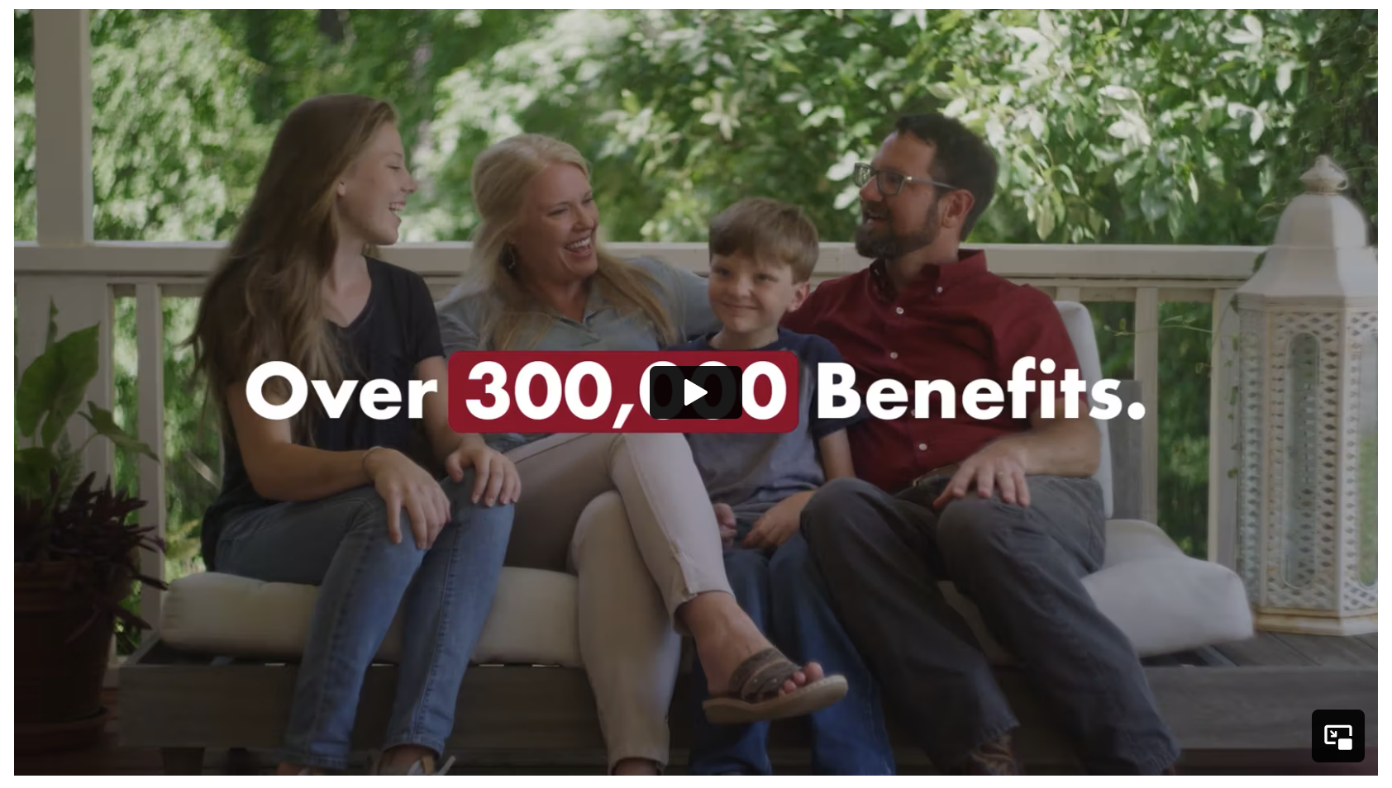

Slide 28
QUESTIONS

